Slide 1
IBM-PBEL
Full Stack Web Development
Final Project Submission
GNIOT, Greater Noida
1

Slide 2
Vaibhav Gupta
Final-year Computer Science student, GNIOT, Greater Noida
Email ID | Mobile Number | GitHub
gvaibhav.business@gmail.com | +91 92080 12172 | github.com/vaibhv19
Project Title | The Tiffin Dispatch
Domain | Web Development — E-Commerce / Food-Tech (Frontend)
Live Deployment | The Tiffin Dispatch
Repository | github.com/vaibhv19/Food-Ordering-System
2

Slide 3
Problem Statement
The Challenge
Publicly available food-ordering demo projects are typically built around generic, dollar-denominated assumptions that do not reflect a real regional user base. Many student full-stack submissions also stop at a single CRUD flow, without demonstrating a complete, production-style frontend build.
Objective
Component-based React architecture using functional components, hooks, and the Context API for state management
Client-side routing between distinct application views (menu, checkout)
Integration with a live third-party REST API for real product data
A complete user journey: browse → search/filter → cart → checkout → confirmation
Regional personalization for an Indian audience — currency, dietary norms, and location
3

Slide 4
Proposed Solution
The Tiffin Dispatch is a frontend-only React application that reproduces a restaurant ordering experience end-to-end, built for academic evaluation rather than commercial deployment.
Cart state is managed globally through the Context API and stays consistent across the menu, cart drawer, and checkout views
Client-side routing (React Router) separates the menu experience from the checkout flow
A dedicated API layer fetches category and meal data from TheMealDB; since the source has no real pricing, a deterministic price generator produces a stable, session-consistent price (in ₹) per dish
The full user journey is implemented: category browsing, search, price/dietary filtering, a saved-favorites view, a quantity-stepper cart, a pickup/delivery checkout, and a printable order receipt with a generated order number
All commercial elements — pricing, checkout, and receipts — are explicitly simulated: no backend service, no database, and no real transactions occur
4

Slide 5
Technology Used
Frontend
React — functional components, hooks (useState, useEffect, useContext)
State Management
Context API — global cart and favorites state
Routing
React Router — client-side navigation between menu and checkout
Styling
TailwindCSS — utility-first styling, custom typography and color tokens
Build Tool
Vite — development server and production build
Data Source
TheMealDB — free public REST API, no API key required
Pricing Logic
Deterministic client-side price generator (₹150–₹630 range), keyed to meal ID for session-stable pricing
Backend
None — this is a frontend-only simulation; no server, no database
5

Slide 6
Application Architecture
User
React Components
React Router
Browser interaction
MenuPage, CheckoutPage, MealCard, etc.
Client-side view routing
Context API
API Layer
Global cart & favorites state
src/api/meals.js — fetch + price logic
TheMealDB REST API
State flows one way: user actions update Context; components re-render from Context and API-layer data. No server-side component exists in this application.
External live data source (no key required)
6

Slide 7
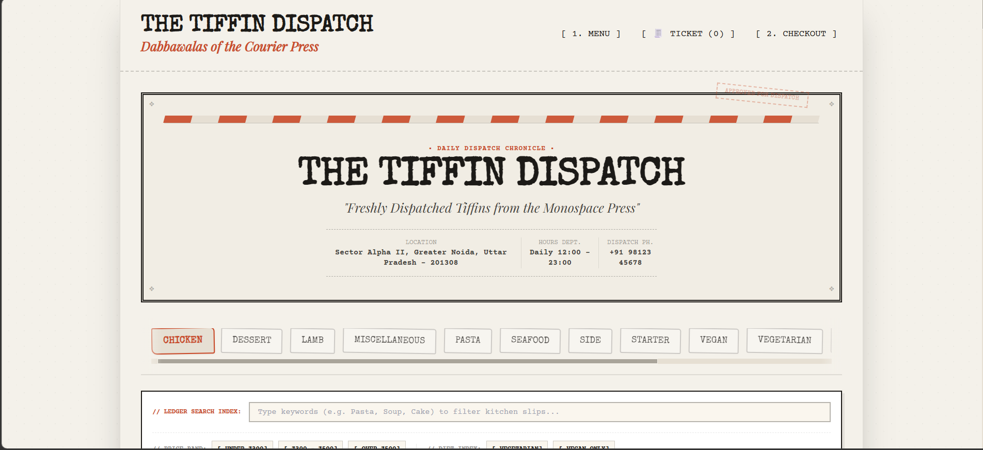
Application Screen — Menu & Search
Category browsing, search, and price/dietary filters
7

Slide 8
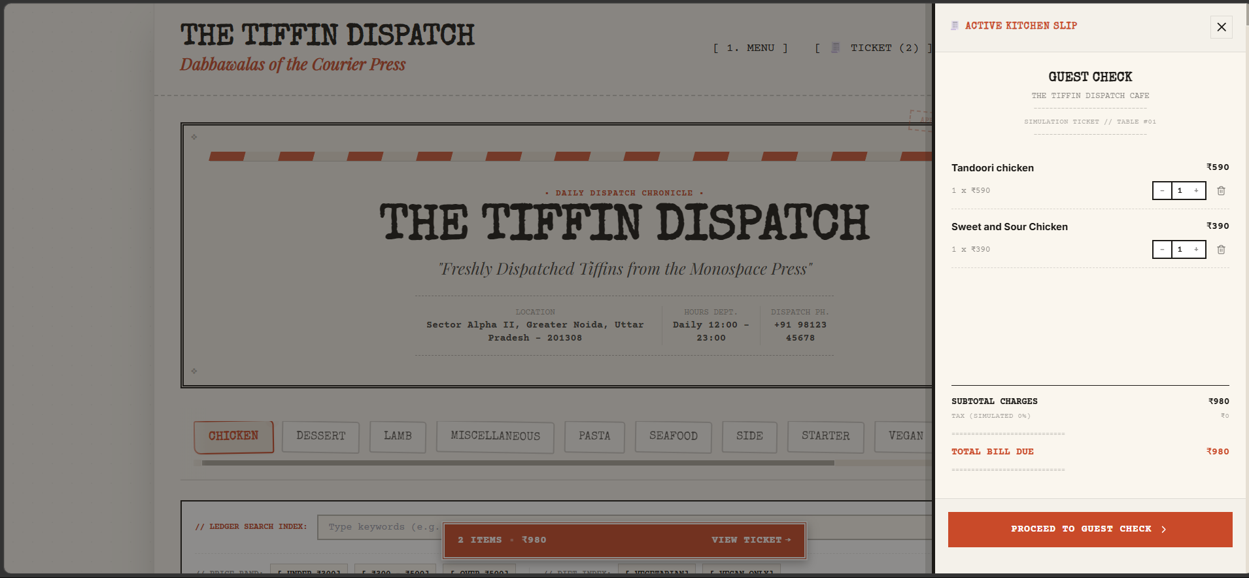
Application Screen — Cart
Cart drawer with quantity stepper and running total
8

Slide 9
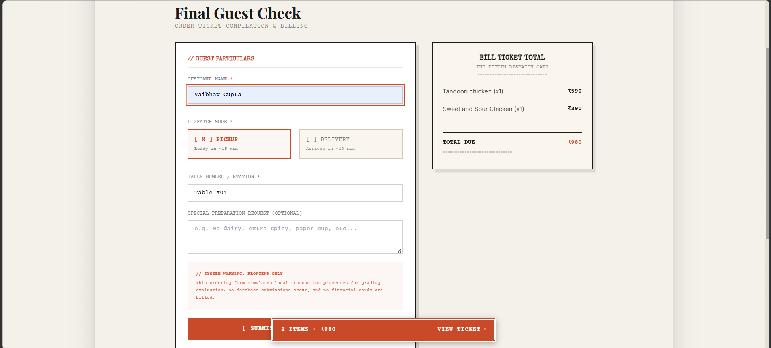
Application Screen — Checkout
Checkout form, pickup/delivery selection, and order summary
9

Slide 10
Regional Personalization
The application was adapted for an Indian audience rather than left with the default assumptions of the underlying data source.
Currency
All prices, subtotals, and checkout totals are shown in Indian Rupees (₹), with mock values scaled to a realistic ₹150–₹630 range rather than a direct dollar-to-rupee symbol swap.
Dietary exclusion
Beef and pork items are excluded from category listings and search results, filtered at both the category level and the individual-item level (source data places some items outside their expected category).
Location
The application's contact/location details reflect a Greater Noida, Uttar Pradesh address and an Indian mobile number format, rather than a generic placeholder.
10

Slide 11
Repository & Live Deployment
GitHub Repository
github.com/vaibhv19/Food-Ordering-System
Live Deployment (Vercel)
The Tiffin Dispatch
README.md (in the repository) includes setup instructions, full feature list, project structure, and a note confirming the checkout flow is simulated for grading evaluation.
11

Slide 12
Thank You
Vaibhav Gupta
gvaibhav.business@gmail.com • +91 92080 12172 • github.com/vaibhv19
12

